Slide 1







Get Up & Goals
Let’s Make a World of Difference
Teacher Training Package
Getting the most out of the GUAG Teaching and Learning Resources

Slide 2

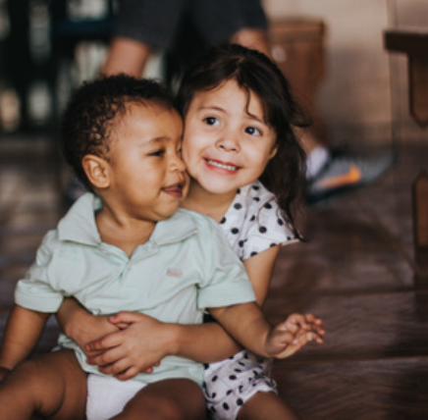
Are you ready?
Getting Started
An introduction to global learning
Contents of the toolkit
Are you ready? Getting Started
Step One Training your staff
Step Two What is global learning all about?
Step Three Using the SDGs with pupils- mapping against the curriculum
The GUAG project – What are the project elements ?
The Teaching and Learning Resources and the Big Ideas
Measuring the impact of lessons- using the tools to assess[ baseline and end line assessment]
Action Campaigns- Giving young people a voice
Developing the Global School- using the self assessment tool
The Geo History Textbook
*
Let’s make a world of
difference
.

Slide 3
Step 1
Getting Started
Are you ready?
Getting Started
An introduction to global learning
The aims of the toolkit
This GUAG toolkit will introduce you to the project and the potential impact of global learning . It will also give you the background on the Sustainable Development Goals and give some easy ways to integrate these into your teaching.
The project aims and objectives will be shared along with the outcomes of the project and the different free resources that you can choose to use in the classroom.
Each tool of the project will be explained to enable you to get the best outcomes for your young learners.
This Training guide can be used to share with colleagues in a simple way how the resources from the Get up and Goals project can benefit and thus act as a quick training package to support teachers as they embed this important focus into their classroom.
For Teacher action- some slides will give learning activities to support the best use of this new and exciting resource.
*
Let’s make a world of
difference
.

Slide 4


Training Teachers
Step One
Staff delivering PSHE/ Citizenship lessons can deliver the TLUs to their Key Stage 3 classes . The lessons are quite easy to deliver with minimum preparation or photocopying.
However, it has been shown that where staff have a better understanding of the key messages they take more ownership of the delivery and it has a greater impact on pupils.
It would be helpful if staff did the following before the first lesson:
Read through this training package.
Watched at least 1 clip on the SDGs.
Looked at the ‘ Big Ideas’ for the TLU they will deliver.
Discussed with you the best way to measure the impact of these lessons, this could be done through the assessment tools.
Explore the project website:
Remember:
This project can impact on the following as well as teachers :
Students
Whole School initiatives
The Organisation/ Community eg governors, finance department parents, community
Different groups may need support , information and training

Slide 5

Step 2
Getting Started
An introduction to global learning
Sustainable Development can be seen as two things...
The first is that we
find a way of living
our lives, so that we
do not cause harm to
other people or to the environment.
The other aspect is that we live our lives in a way that means there will continue to be enough resources for
people in the future, so they can live decent, dignified and rewarding lives, too.
...both of these aspects are important.
We do not want to use resources in a way that means our children or grandchildren are left without what they need, and we do not want to do things to the earth that make it harmful to live here, for people or animals. If we can change how we use resources – for example, to make them last longer, -then this is called behaving in a sustainable way.
.

Slide 6
An introduction to the
Get Up and Goals! Project
“Be a global citizen... Help us make this world safer and more sustainable today and for the generations that will follow us.”
Ban Ki-moon.
(Secretary-General of the United Nations, in 2016)
*
It is a 3-year project funded by the EU with the aim of raising awareness of the 17 Sustainable Development Goals (SDGs) amongst teachers and young people in twelve European countries. The project has a number of different aspects.
Firstly, the creation of the Teaching and Learning Units (TLUs) on four important topics; Economic Migration, Asylum Seekers, Climate Change and Gender and Women. The resources developed in these units are to support teachers in the classroom and provide them with up to date, topical and relevant lesson resources.
Other aspects include working with teachers in other countries to support young people learning about the SDGs, develop a Geo-History Textbook for use across the partner countries, supporting young people in developing awareness campaigns and helping teachers better understand the Sustainable Development Goals (SDGs).
.

Slide 7



Step Two
Objectives of the project.
There are shared objectives across the project that could benefit your pupils. These are:
• an increased knowledge of key issues and their complexities around the SDGs.
Pupils will be helped to reflect and evaluate all aspects of these important issues and start to consider their own views and behaviour and how this should and can be modified to affect positive change.
• to be helped to apply their knowledge and understanding into different aspects of their lives that link to the SDGs
eg. personal decisions around transport, consumption, energy use, aspiration and equality.
• to have the opportunities to consider their behaviours and become ‘change agents’ and influence the values and actions of others.
This could be in a school setting or in the wider community.
Becoming an active global citizen
As a result of learning about these issues many pupils will start to develop ideas around action and awareness campaigns and spread messages to wider communities about how we all need to respond to particular challenges like climate change.

Slide 8
Getting Started
Global learning can increase critical thinking and motivate your pupils
Step 2
An introduction to global learning
Preparing young people for the challenges of an increasingly globalized, complex and rapidly changing world .
Global learning is an approach that enables young people to start to think about global issues through recognising the importance of linking peoples lives throughout the world. It encourages critical examination of global issues and awareness of the impact that individual's can have on these.
Global learning is essentially education for a fair and sustainable world. In other words, a world free of poverty where all human beings are treated with respect and dignity and where individuals, communities, businesses and countries behave in a way that meets the needs of the present without compromising the needs of future generations. Key global learning concepts include poverty, global inequality, social justice, sustainable development , global citizenship, interdependence, conflict resolution, diversity , values and perceptions and human rights
Sustainable development is about creating a positive future, considering the interdependence of social, economic, environmental, and political aspects of our world. It helps us address major global challenges facing the world today, such as climate change
What do we need to think about? Questions to consider:
What opportunities are there for young people to engage with these issues?
How can teachers provide spaces for meaningful engagement?
And how can we avoid feeling overwhelmed?
.

Slide 9
Step 2
Step 2-Making the case for global learning
An introduction to global learning
How does global learning help young people?
*
It encourages the development of critical thinking skills about world problems
It can develop greater self awareness and open mindedness towards difference
It promotes creative thinking
It can inspire optimism and action for a better world.
It enables greater understanding about power relationships
It embeds an awareness of their own actions and the impact of these on others
It gives opportunities to examine global problems from the perspective of people from around the world
It gives opportunities for the evaluation of how we can use resources efficiently to limit the impact on the environment and other people
Think Global definition :https://think-global.org.uk/global-learning/theory-of-change/
.

Slide 10
Sustainability Skills
An introduction to global learning
Using resources efficiently to limit the impact on the environment and other people
Looking at global problems from the perspective of people from around the world
Considering ethical issues linked to your subject
The causes of inequality in the world
Understanding how to create change
Understanding how human activity is affecting nature
Challenging the way we do things now (like business, politics, education)
Solving problems by thinking about whole systems –including different connections and interactions
Communicating complex information clearly and effectively to different types of people
Understanding how to create change
Looking at a problem using information from different subjects or disciplines
Planning for the long term, as well as the short term
*
.

Slide 11
Making the case for global learning
Step 2
An introduction to global learning
Where should we see global learning on the school curriculum?
*
Across the curriculum :
It would have a positive impact if all young people leaving school were able to offer solutions to social, economic and environmental challenges. This would be possible if all curriculum areas engaged with global learning.
Across the school grounds and buildings : By making sustainability part of everyday life across primary and secondary schools it would enable young people to see responsible behaviours as a way forward in their future lives..
Into the Community: If we can help young people to thrive as global citizens, as active participants in society and democracy, and as future leaders on sustainability.
.

Slide 12
Step 3
What are the SDGS?
Using the Sustainable Development Goals with pupils
An introduction to global learning
There are 17 Sustainable Development Goals
These new goals are called the Sustainable Development Goals (SDGs) and there are 17 of them in all. A new date of 2030 was set to try to achieve them by. The statement that ‘no one in the world is left behind’ became the basis for the goals, and that all countries would aim to end poverty, stop inequality, and tackle climate change.
They are also known as ‘Global Goals’ , they apply to all people, young and old, in the UK and in everyone of the 193 countries that signed up to them in 2015. It is the responsibility of all governments to ensure that countries move towards the targets set out in these goals.
But we can all play an important part in achieving them.
*
The Get up and Goals! Project is all about these SDGs and has the objective of increasing pupil, teacher and community awareness of what these goals stand for and how they can help support positive changes in communities around the world.
Many schools are now integrating the SDGs into the school curriculum and extra curricula activities, leadership schemes etc
So where do these Global Goals best fit into the work of busy schools?
.

Slide 13
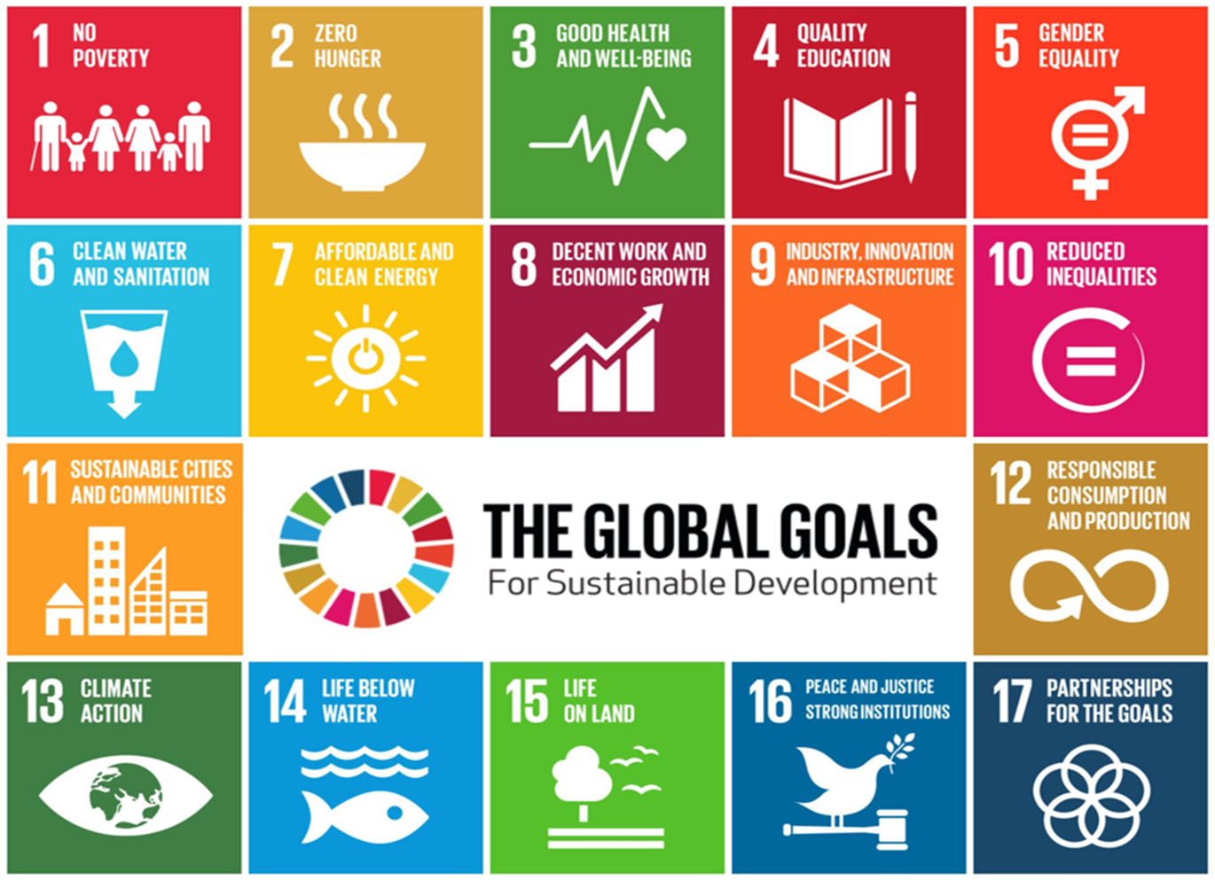
How can the SDGs support school curriculums?
Step 3
An introduction to global learning
These are the 17 Sustainable Development Goals.
*
.

Slide 14

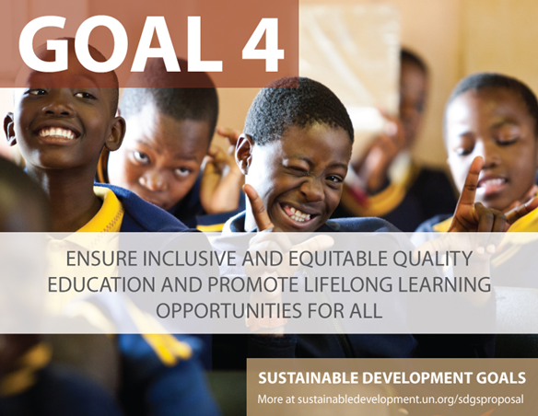
Goal 4 Quality Education for all?
Step 3
An introduction to global learning
Target 4.7 is of particular relevance to schools as it states that by 2030 they need to :
‘to ensure inclusive and equitable quality education and promote lifelong learning opportunities for all.’
.

Slide 15
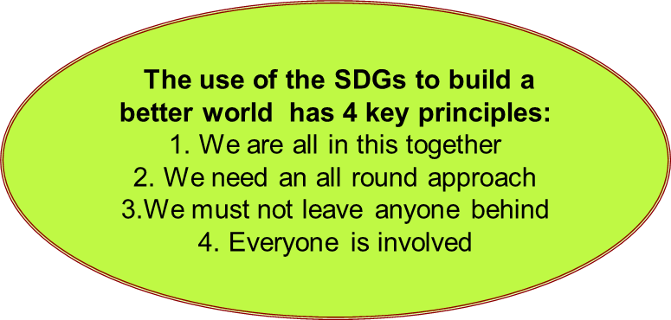
Step 3
Many teachers like to use the principles of the global goals
An introduction to global learning
Global Goals principles
*
No one left behind, ensuring human rights are enjoyed by all
Sustainable development at the core, transforming our use of natural resources
Changed patterns of consumption and production, creating a more equitable world
Peace and accountability for all states and Institutions, promoting the well being of all
Partnerships for global social justice, merging environment and development agendas.
.

Slide 16
How can the SDGs support school curriculums?
Step 3
An introduction to global learning
.
The SDGs can link to many important themes explored in schools in the UK.
Globalisation and Interdependence
*
Social Justice
peace and Conflict
Global Citizenship
Human Rights
Identity and Diversity
Sustainable Development
.

Slide 17
Primary Schools
SDGs can be integrated throughout their curriculums
SDGs used for assembly and project themes
Schools can link them to other global projects
The goals link to themes such as equality, diversity, active citizenship, climate change.
The Global goals help pupils explore the local to global links
They can be linked to staff training
Linked to a change in teaching methods[ eg active learning, critical thinking P4C etc]
Linked to work in the community with parents
Secondary Schools
The SDGs can help to engage and motivate pupils
Shows how learning / problem solving can link to real world challenges
The Global Goals can links to active citizenship
The SDGs are popular in PSHE/ Citizenship, can feed into Geography, RE and other subjects
They can be used for drop down days
They can feed into SMSC/ Personal Development

Slide 18

Teacher Action Page
Time to get thinking and planning
An introduction to global learning
For my practice
To reflect: Key questions to think about today
How can global learning contribute to learning and pupil outcomes?
How could you embed global learning into your everyday classroom practice?
What impact do you think it would have on your teaching if you adopt a GL approach? Consider both the curriculum and your pedagogy
What might pupils be able to do differently as a result of a global learning focus in lessons?
*
.

Slide 19
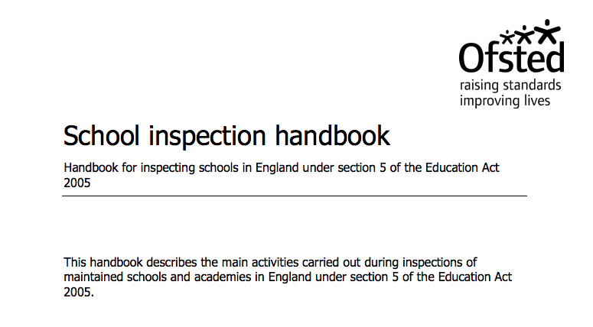
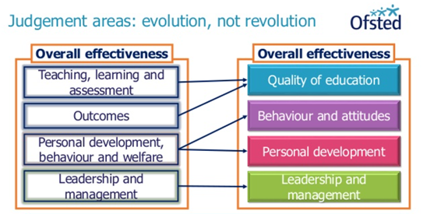
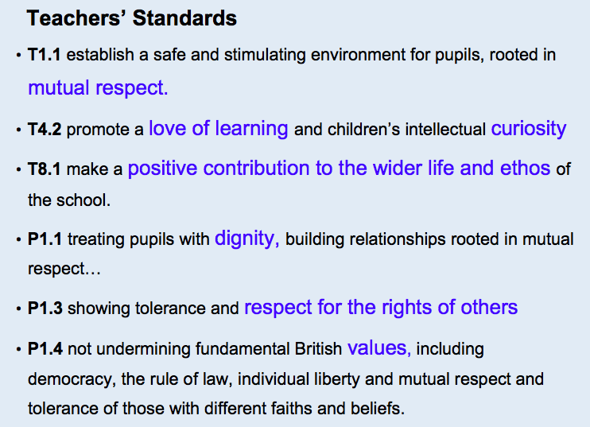
The SDGs can support schools as they work to meet the following government policies on school curriculum
Step 3
An introduction to global learning
*
PSHE Personal, Social
Health and Economic
Education
Personal development,
behavior, welfare and safeguarding
Relationship and sex education (RSE) and Health Education compulsory from Sep 2020
SMSC Spiritual, moral, social, cultural Development
Personal development
.

Slide 20
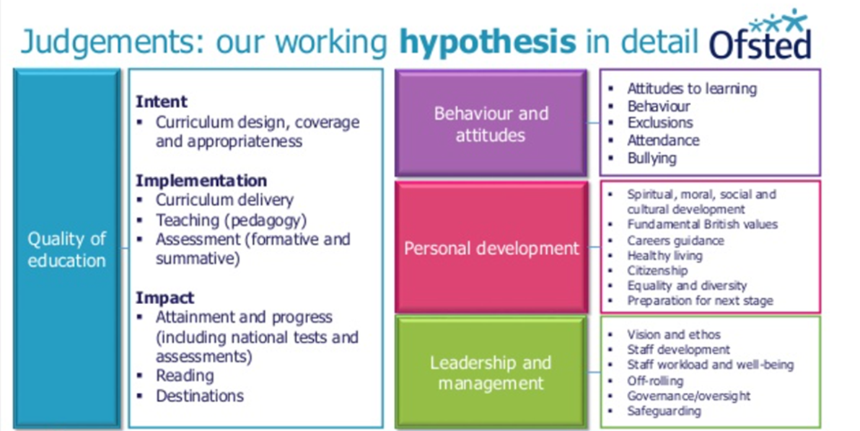
Fitting the SDGs into school curriculums
Looking at curriculum intent, implementation and impact
Step 3
An introduction to global learning
*
.

Slide 21
Step 3
Using the SDGs to support Personal Development
Where might it fit?
In the Curriculum
Consider all subject areas but especially the Humanities, MFL, Science and English but can be embedded through Key Stage 3 curriculums.
In our enrichment activities
Consider as a focus for student debates, projects , drop down days Eco Clubs and school councils.
Link to pupil projects/assemblies
The Global Goals offer an opportunity as they encourage young people to learn and think critically about real world issues and to act in response to their learning:
The SDG framework can support a ‘more critical and engaged approach towards learning’.
You can link the SDG themes to all curriculum areas and there are opportunities to move from learning and thinking to acting and wellbeing whether at school, local community or global linking level.
SDG4 Target 7 – explicitly recognises the need for education for sustainable development and global citizenship
Focus on the fact that these global challenges will only be solved if all generations work together but big business and government also have a role to play.

Slide 22
Step 3
Using the SDGs to support the curriculum
How can I get Started?
Increasing my knowledge
Start your research by checking out these resources and clips
https://think-global.org.uk
GlobalGoalsThe World's Largest Lesson | Global Goals
https://www.youtube.com/watch?v=cBxN9E5f7pc
https://sdgzone.com/learn/what-are-the-sdgs
Student Action
https://www.childinthecity.org/2018/06/22/give-young-people-a-voice-on-global-issues/?gdpr=accept
Youth realizing the Sustainable Development Goals
https://www.youtube.com/watch?v=ccE5x3-fYzs
Greta Thunberg
https://www.youtube.com/watch?v=u9KxE4Kv9A8
https://www.globallearningni.com/uploads/myresources/good_practice_poster.pdf
https://www.youtube.com/watch?v=xVWHuJOmaEk&feature=emb_logo
https://www.youtube.com/watch?v=xVWHuJOmaEk&feature=emb_logoNations United: Urgent Solutions for Urgent Times | Presented by Thandie Newton
/

Slide 23
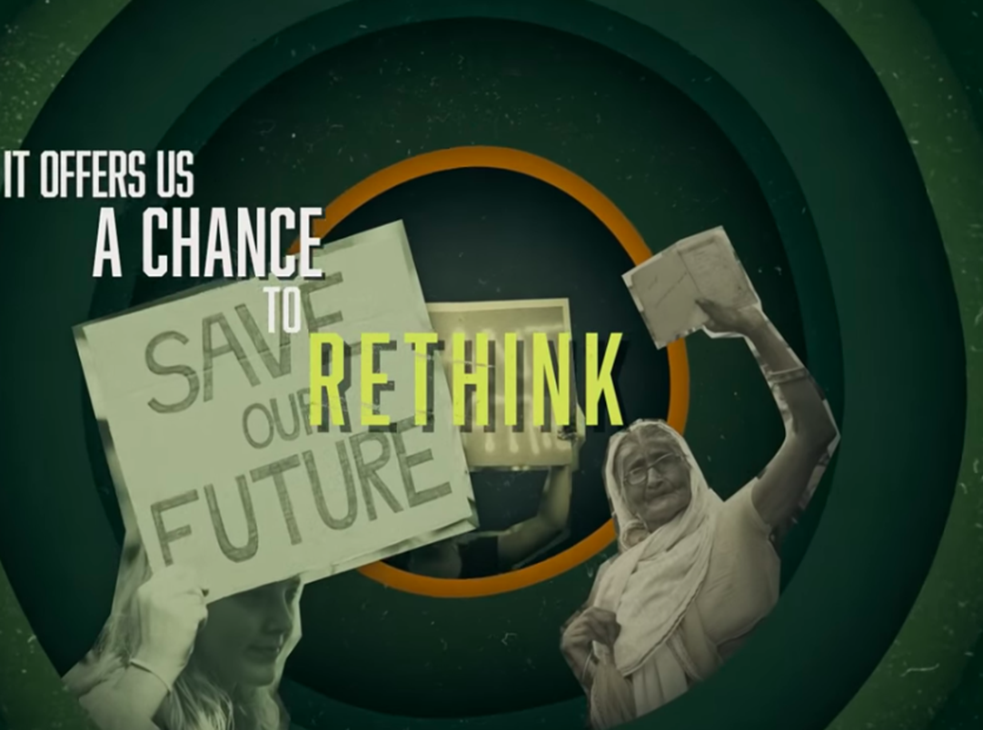
Oxfam EDUCATION RESOURCES
The Sustainable Development Goals: A guide for teachers
https://oxfamilibrary.openrepository.com/bitstream/handle/10546/620842/edu-sustainable-development-guide-15072019-en.pdf;jsessionid=E147F690DA21F0616B6230D519A930AE?sequence=4
Teaching Controversial Issues: A guide for teachers
https://oxfamilibrary.openrepository.com/bitstream/handle/10546/620473/gd-teaching-controversial-issues-290418-en.pdf?sequence=1
Post Pandemic – A moment to rethink education
https://worldslargestlesson.globalgoals.org/resource/the-pandemic-is-a-portal/

Slide 24
The Impact of Covid 19 on achieving the sustainable Development Goals
‘We cannot tire or give up. We owe it to the present and future generations of all species to rise up and walk’
Wangari Maathai was a renowned Kenyan social, environmental and political activist and the first African woman to win the Nobel Prize.
A lot has changed in the last few months and years .Young people are now in an even more uncertain world faced by the global challenge present by the COVID 19 pandemic. The SDG framework could be a useful way to frame future discussions.
Young people will need time and space and to be guided by educators to make send of our new normal.
They need to critically reflect on the present and consider their contribution to the future and especially the challenge of leaving no one behind.
These resources can be used in a variety of ways to engage young people in these vital topics, to explore issues and consider solutions. They will learn to voice an opinion and listen to the opinions of other.

Slide 25
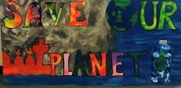
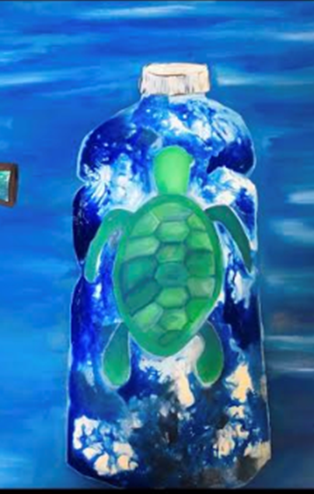
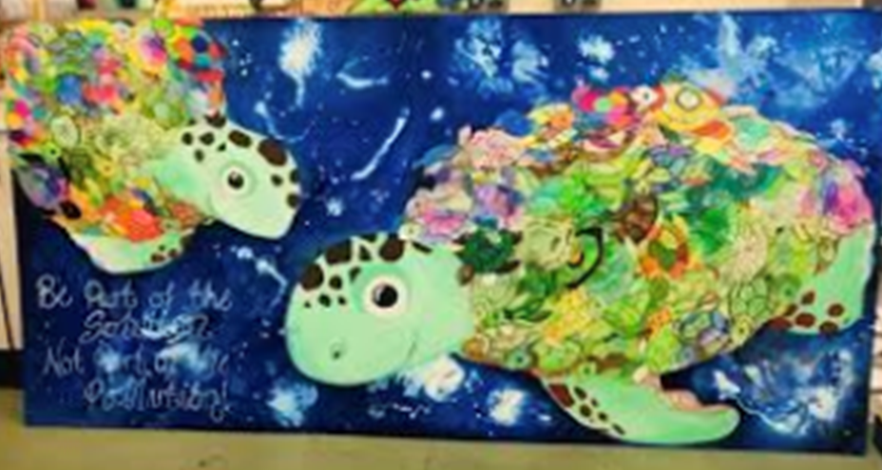
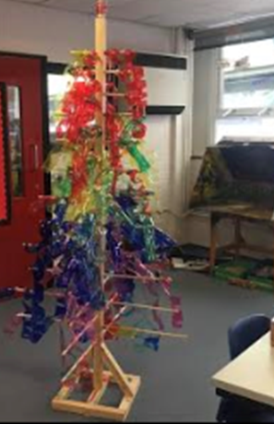
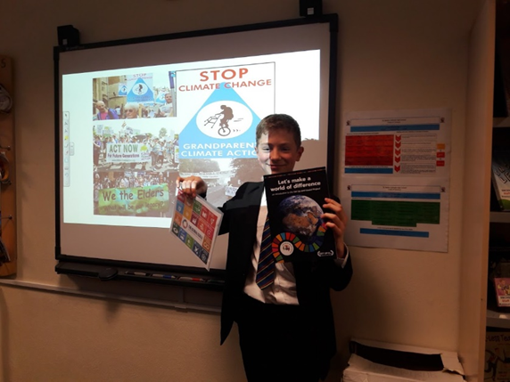
Get Up & Goals
Let’s Make a World of Difference

Slide 26
Teaching and Learning Units (TLUs) / Schemes of Learning
1
Why choose to use these resources?
They have been mapped with the curriculum for PSHE, Citizenship, SMSC (Spiritual, Moral, Social and Cultural) and British values.
They will help to support teachers and pupils to become more aware of challenging global issues such as climate change, inequality, gender inequality and migration.
They are fully tested in the classroom as part of the project has had teachers monitoring their use and have provided evaluations and pupil feedback on the content and activities.
These TLUs have been written especially for the project.
2
These resources will help pupils investigate a range of challenging issues:
How does gender inequality impact on women’s lives around the world?
Why is it important that women are involved in leadership and decision making?
How will the Sustainable Development Goals help to improve the lives of people around the globe?
How do we ensure that no-one will be left behind in 2030?
How will we develop responses to the impact of climate change?

Slide 27
Teaching and Learning Units (TLUs) / Schemes of Learning
A
Choose the global issue
CLIMATE CHANGE
B
TACKLING GENDER INEQUALITY

Slide 28


Teaching and Learning Units (TLUs) / Schemes of Learning
C
Choose the global issue
D

Slide 29
3
How will this resource help teachers?
Saving Teacher Time- lessons that provide topical, relevant information with engaging stimulus.
Complete lessons ready to go. Teachers will have a lesson from start to finish that includes, facts, images and interactive activities.
Choices Each lesson can be delivered as a separate session or you can pick and adapt to fit the needs of your pupils and the school context.
Easy to use. Each lesson is presented on a power point with additional pupil worksheets . Limited photocopying is needed.
4
How will these lessons benefit young people?
Encouraging thought , reflection and action. Information and stimulus is presented in a way that encourages pupils to get engaged.
Foster Understanding that the Global Goals could make the world a better place. Pupils are helped to understand the value of the SDGs to them and the wider world .
Through these lessons young people are invited to really think about the critical issues that face the world as we move towards 2030.

Slide 30
5
What are the Big Ideas?
What should pupils know by the age of 16?
The Big Ideas act as a guide for the content of each TLU. They are the key things pupils should know about the 4 issues by this age. This is to help pupils understand these complex and sometimes controversial global issues.
The ‘big Ideas’ gives the teacher an overview to enable effective planning.
Choosing a relevant focus . Teachers can choose Big Ideas to focus on and can monitor student progress using the Learning Assessment Tool.
6
Testing the TLUs
How? A set of assessment tools related to the Big Ideas have been created. These help teachers assess their students’ progress on their knowledge, competences and willingness to act.
What do I do? To assess progress, you will find 4 questionnaires to measure knowledge about climate change, gender inequalities, migration and international inequalities.
Add in 2 more tools. There are tools to assess both global skills and attitudes stimulated by the TLUs and active lessons.
Assessing progress. By giving students the same tool before and after the course you will have the opportunity to assess the progress of your classes.
Assessment
How can we know if these lessons are making an impact?

Slide 31
7
Having a voice: Student Action Campaigns
CREATIVE ACTION CAMPAIGNS!
Being a global responsible citizen.
The GUAG project should inspire students to take action to spread the word on the issues they feel strongly about. They are encouraged to make connections between the local and the global and teachers can use the TLUs to promote students ‘responsible action within their communities for a more peaceful and sustainable world.’
It is good to get the campaign into the wider local community. There are lots of exciting ways to do this.
8
Having an impact and getting the issue out to the community You might like to think about suggesting the following formats for pupils to use as part of their creative campaign:
Visual arts (graffiti, painting, murals, collage, installation)
Animation (stop frame, illustration, film)
Drama (performance, video)
Dance (performance, video)
Music – urban, acoustic, classical, singing, playing (performance, video)
Multi-arts project including a mix of any of the above
How can young people spread the word and play a committed leading role?

Slide 32
9
What is the Geo History Textbook?
The project provides History and Geography teachers of secondary school students with an innovative reference book . The aim is to spread a new historical narrative in schools to help overcome both nationalism and Eurocentrism.
The Educational Goals are:
To narrate history to all European and world citizens: To help students and teachers choose important historical elements:
To narrate history in a clear way:
To explain the great problems of today:
‘ thinking differently’
10
Theme one: Humans change nature.
This highlights the outcomes produced by human actions within nature: how nature is used, transformed and exploited, and how this affected humans and human history.
Theme two: Humans on the move
This highlights the expansion and abridgment of human populations. Migrations have existed for hundreds of thousands of years, since the very beginning of the human species.
Colonisation also triggered the movement of humans over large distances. Colonialism is the conquest, possession and direct control of territories that belong to other human groups
Why don’t you take a look and explore this exciting new resource.

Slide 33
11
What is the Geo History Textbook?
Theme three: Social organisation and inequality
This focuses on societies and how they have been built, organised, managed, controlled, and governed.
It traces the long story of inequality, its origin, and the struggles that emerged from it, such as the resistance of indigenous populations to the contemporary movements demanding commons and climate justice.
This covers human actions in terms of protests, conflicts, and revolutions.
12
Theme four: Worldviews
This covers acts of imagination, with beliefs, views of the world, and ideals that humans have created throughout history.
.
New, Innovative and exciting
The resulting contents and educational approach aim at overcoming ethnocentrism and enhance students’ ability to place specific issues in a broader and more global dimension.
Why should you consider this resource?

Slide 34
13
Using the toolkit to become a
‘Sustainable and global school’
GUIDE FOR SUSTAINABLE AND GLOBAL SCHOOLS. This is a self-assessment tool aimed to support headteachers, teachers and parents through a collection of good practices and evidences. It gives schools a set of benchmarks at three different levels and examples of relevant evidence for each level . This can help schools monitor progress towards a set of goals and lead to celebrating success as the school moves to become both more sustainable and more global.
The Global Citizenship Framework is intended for you to use as a tool to help you in delivering Global Citizenship Education[ G.C.E with a particular focus on the U.N. Sustainable Development Goals.
14
Why use this toolkit?
To plan regular integration of Sustainability and G C E into school’s
To highlight the value of teachers’ work
To measure the progress of the whole school community
To encourage anyone involved schools to adopt sustainable practices
To appreciate and support diversity and prevent prejudices and exclusion
To inspire waste reducing and recycling
To boost the creation of green spaces in schools
A great tool to recognise the work of teachers and schools. It alSO provides evidence for school Ofsteds.

Slide 35
15
What does the Toolkit do?
The Guide assesses and evaluates the school according to six criteria:
Students’ involvement and activation
How many teachers do adopt global citizenship education approach? How many students promote citizenship actions in/out of the school?
Teaching and learning
How many subjects taught in your school address topics related to the 2030 Agenda?
Communication
How many of your school community know/are informed about the Sustainable Development Goals of the 2030 Agenda, also through your institutional website?
16
Resources, supplies and selection
How much does your school apply environmental and social sustainability standards when buying food, equipment, and any other goods? Has the school adopted a re-using-recycling system?
Leadership and management
How much are global citizenship education values embedded in your school mission statement and action planning?
Staff development
Does your school promote Global Citizenship Education trainings for teachers?
A great tool to recognise the work of teachers and schools. It alos provides evidence for school Ofsteds.

Slide 36
SPERIMENTAZIONE DELLE UNITÀ DI APPRENDIMENTO (UDA) - LINEE GUIDA
17
Here are some final thoughts from some teachers who have used this reosurce.
‘’The TLU’s used in the Geography department show that the Climate change resources had a significant impact on pupils understanding. Pupils recalled the impact of Climate Change on the Marshall Island a year after studying the TLU.’’ ‘
Assistant Head teachers St Bede’s Catholic High School, Omskirk.
‘’I’ve now embedded Climate and Gender within our PSHE & Citizenship programme so that they are always delivered in Years 8 and 9 respectively.’’
‘’Global learning and the GUAG project is exciting and interesting for students.’’ Head of PSHE / Citizenship Maricourt High School , Maghull
18
‘’Our students were inspired to start a school Eco Group in response to the TLUs we did on Climate Change. These were then the core group who got involved with the Creative Action Campaign.
More recently, our students have been inspired by Marcus Rashfords campaign for free school meals during the holidays and as part of a Global Citizenship lesson students decided to start a foodbank collection for our local community foodbank.
School Chaplain , Edmund Arrowsmith High School
‘’We as a school really have really enjoyed using, teaching and delivering the TLU’s to our pupils and as result have incorporated them in to our teaching plans in many subject and PSCE areas. ‘’Head of PSHE/Citizenship, Rainill High School

Slide 37
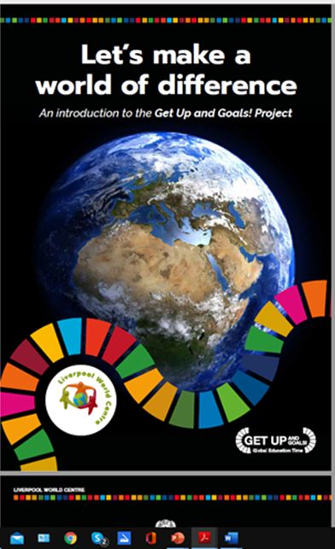
Start to explore these free reosurces .
Check out EU project website:
www.getupandgoals.eu/
Have a look at the Geo History Textbook at:
www.getupandgoals.eu/resources/textbook
11
Check out the Uk website:
www.guag.liverpoolworldcentre.org
Have a look at these exciting lesson activities developed in video to show to pupils:
guag.liverpoolworldcentre.org/student-action-resources

Slide 38
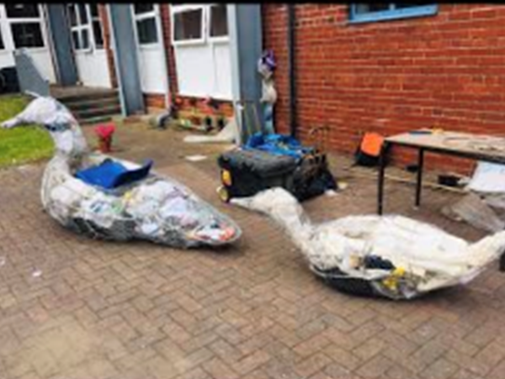
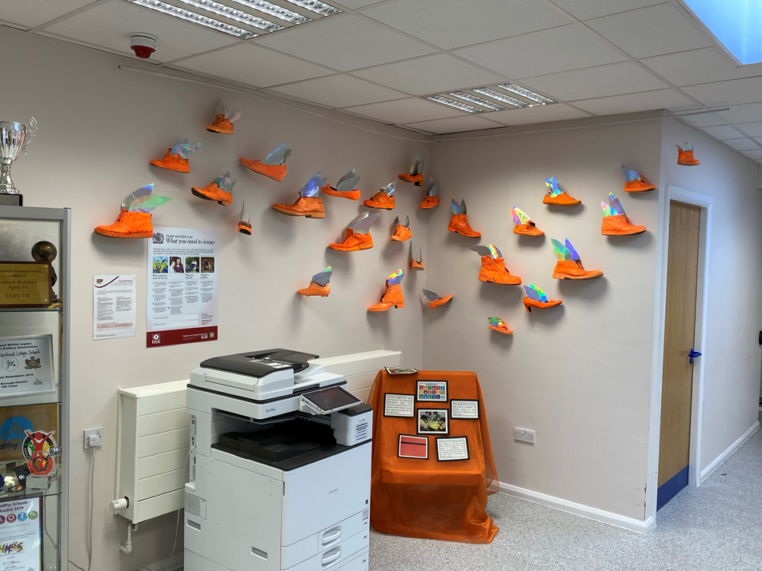
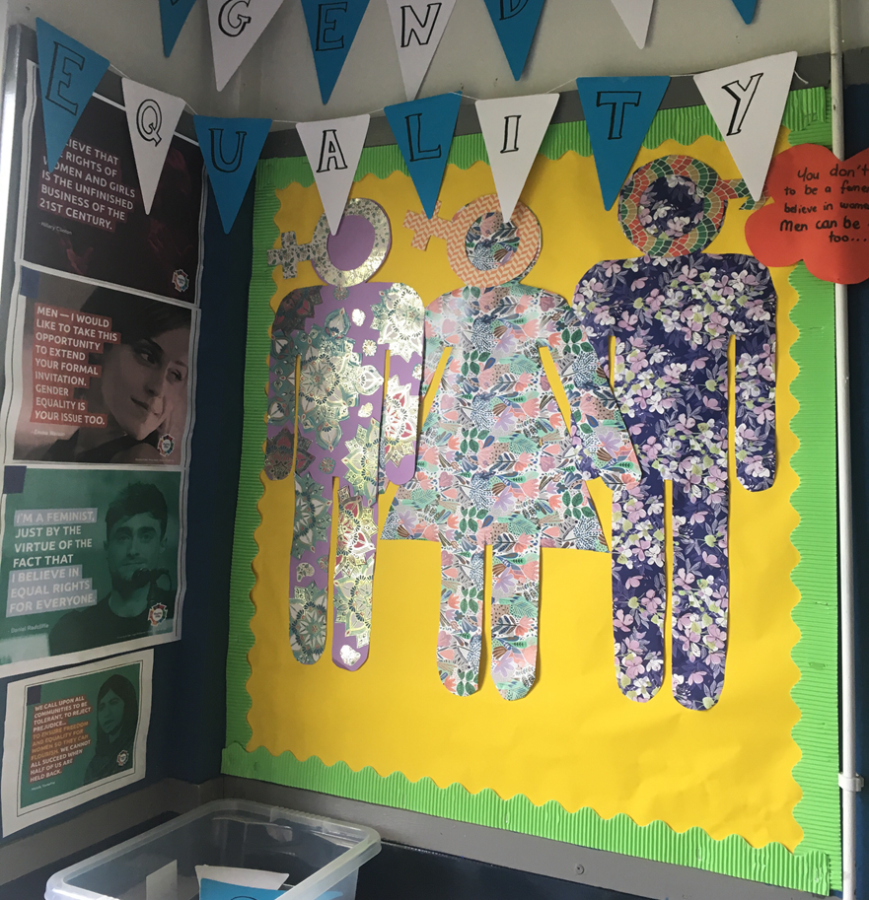
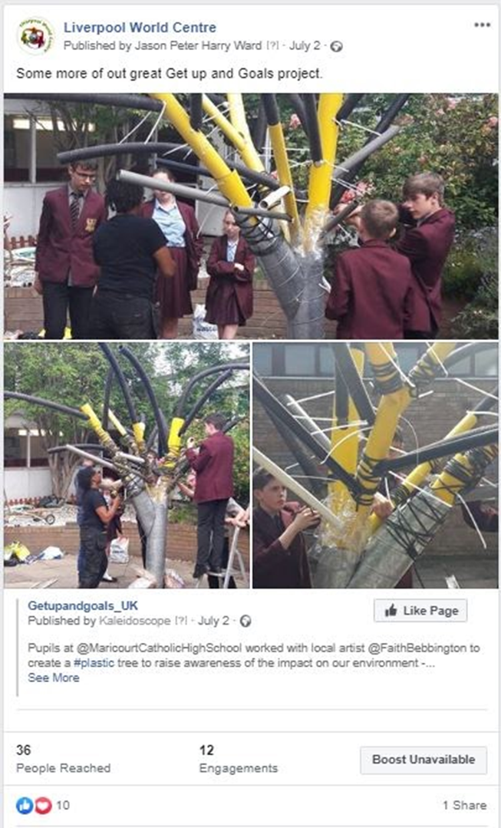

Slide 39



This resource has been created as part of Liverpool World Centre's ‘Get Up & Goals’ project. The project is co-funded by DEAR (Development Education and Awareness Raising) Programme of the European Commission. This resource was created with the financial support of the European Union. Its contents are the sole responsibility of Liverpool World Centre and do not necessarily reflect the views of the European Union.

